Slide 1

Stock Price Prediction
Department of Computer Science and Engineering
V Vaishnav- 17113027
Sidharth R V-17113035
Sudarshan U-17113059
Mentor: Dr.S. Sathyalakshmi

Slide 2

Introduction
Stock market prediction aims to determine the future movement of the stock value of a financial exchange. The accurate prediction of share price movement will lead to more profit investors can make.
Predicting how the stock market will move is one of the most challenging issues due to many factors that involved in the stock prediction, such as interest rates, politics, and economic growth that make the stock market volatile and very hard to predict accurately.
The prediction of shares offers huge chances for profit and is a major motivation for research in this area; knowledge of stock movements by a fraction of a second can lead to high profits.
Since stock investment is a major financial market activity, a lack of accurate knowledge and detailed information would lead to an inevitable loss of investment.
The prediction of the stock market is a difficult task as market movements are always subject to uncertainties.
Stock market prediction methods are divided into two main categories: technical and fundamental analysis. Technical analysis focuses on analyzing historical stock prices to predict future stock values (i.e. it focuses on the direction of prices). On the other hand, fundamental analysis relies mostly on analyzing unstructured textual information like financial news and earning reports.

Slide 3

Abstract
The prediction of a stock market web application that may serve as an early recommendation system for short-term investors and as an early financial distress warning system for long-term shareholders
Forecasting accuracy is the most important factor in selecting any forecasting methods
Research efforts in improving the accuracy of forecasting models are increasing since the last decade
The appropriate stock selections those are suitable for investment is a very difficult task. The key factor for each investor is to earn maximum profits on their investments.
We used deep learning and more precisely one of the most famous recurrent neural networks : LSTM, in order to perform stock market prediction
Since it is necessary to mention that stock market prediction is not an easy task since the prediction part could be divided into two : fundamental analysis (sales, earning, profits, …) and technical analysis (historical price, …). Which means numerous factors could affect the stock price trends, but in this tutorial we used only time series forecasting using the historical price of a given stock.
We used Long Short Term Memory, a commonly used RNN. Considering the type of data that we will be feeding our model and the ability of a RNN to allow information to persist unlike standard feed forward neural networks ( they could only process single data points eg : images ), an LSTM is the best fit for these type of problems.
LSTM could easily process an entire sequence of data and it introduces the memory cell, which make the network able to effectively associate memories and input remote in time.
In this example we fed our model with a set of sequences that will help predict a given price using time steps.

Slide 4

Literature Review/Existing Systems
Title of the Paper | Authors | Name of the Conference/ Journal and year of publication | Methodology | Issues / Limitations
Stock Forecasting with Feed forward Neural Networks and Gradual Data Sub-Sampling | Gupta, S. and Wang, L.P | Journal of Intelligent Information Systems/ 2010 | ANN | ANNs are believed to have limitations due to noise in and complexity of stock prices.
Intelligent Trading Using Support Vector Regression and Multilayer Perceptrons Optimized with Genetic Algorithms | Zhu, M. and Wang, L.P | International Joint Conference on Neural Networks (IJCNN), Barcelona, 18-23 July 2010, 1-5 | SVM Regression | The predictive model uses last 8 days PPO as input to predict future 5 days PPO, and based on predicted PPO to make trading decisions.
Prediction of Stock Price Movement Using Continuous Time Models | Masimba E. Sonono, Hopolang P. Mashele | Unit for Business Mathematics and Informatics, North-West University, Potchefstroom Campus, Potchefstroom, Republic of South Africa. 2017 | Brownian Motion (GBM) and Variance Gamma (VG) | A very complex way of programming.
Fundamental Analysis in China: An Empirical Study of the Relationship between Financial Ratios and Stock Prices | Lijuan Ma, Marcel Ausloos, Christophe Schinckus, H. L. Felicia Chong | School of Business, University of Leicester, Leicester, UK. 2018 | SVM Regression | A very basic prediction algorithm. Not effectively being used.
NSE Stock Market Prediction Using Deep-Learning Models | Hiransha M, Gopalakrishnan E.A, Vijay Krishna Menon, Soman K.P | International Conference on Computational Intelligence and Data Science (ICCIDS 2018) | ANN | Only prediction using one dataset. Raises to difficulty for many companies

Slide 5
Objective of the Project
In the past decades, there is an increasing interest in predicting markets among economists, policymakers, academics and market makers. The objective of the proposed work is to study and improve the supervised learning algorithms to predict the stock price.
Technical Objective: The technical objectives will be implemented using deep learning and more precisely one of the most famous recurrent neural networks LSTM. The system must be able to access a list of historical prices. It must calculate the estimated price of stock based on the historical data. It must also provide an instantaneous visualization of the market index.
Experimental Objective: The experimental objective will be to compare the forecasting ability of LSTM. We will test and evaluate both the systems with same test data to find their prediction accuracy.

Slide 6
Proposed System
The investor may choose not to invest all of their funds into a single company lest that company takes unexpected turn.
A more common approach would be for an investor to 3 invest across a broad range of stocks based on some criteria he has decided on before.
This project will focus exclusively on predicting the daily trend (price movement) of individual stocks.
The project will make no attempt to deciding how much money to allocate to each prediction. More so, the project will analyse the accuracies of these predictions
Stock market attracts thousands of investors’ hearts from all around the world. The risk and profit of it has great charm and every investor wants to book profit from that. People use various methods to predict market volatility, such as K-line diagram analysis method, Point Data Diagram, Moving Average Convergence Divergence, even coin tossing, fortune telling, and so on.
Now, all the financial data is stored digitally and is easily accessible. Availability of this huge amount of financial data in digital media creates appropriate conditions for a data mining research. The important problem in this area is to make effective use of the available data.
We propose an online learning algorithm for predicting the end-of-day price of a given stock with the help of Long Short Term Memory (LSTM), a type of Recurrent Neural Network (RNN)

Slide 7
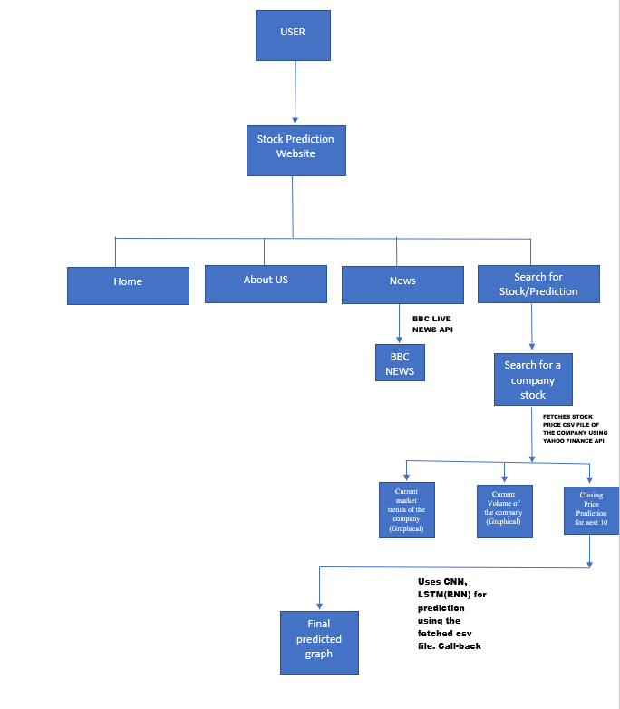
System Architecture

Slide 8
Methodology / Technique
We used Long Short Term Memory, a commonly used RNN. Considering the type of data that we will be feeding our model and the ability of a RNN to allow information to persist unlike standard feed forward neural networks ( they could only process single data points eg : images ), an LSTM is the best fit for these type of problems.
step 1 : Importing dependencies and training dataset
step 2 : Data Preprocessing
step 4 : Building the model
step 5 : Testing the model
Step 6: Cloud Deployment and Front-end Display in Web Application

Slide 9
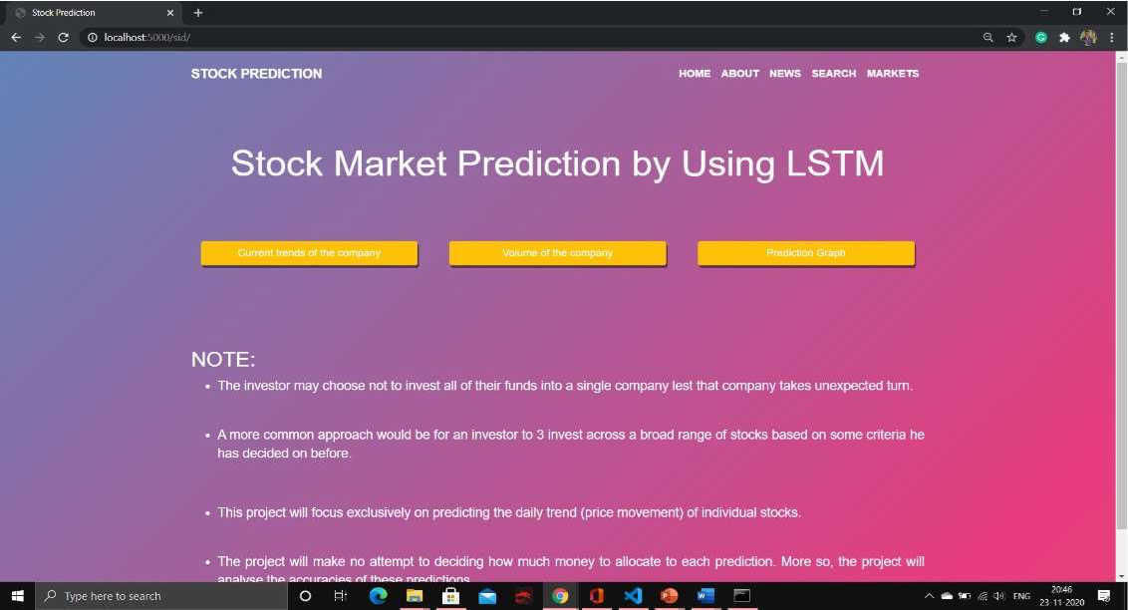
Screenshot

Slide 10
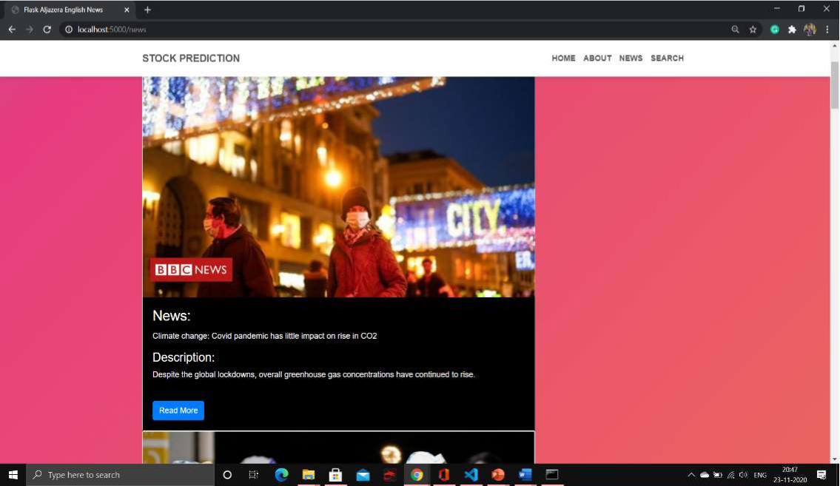

Slide 11
Conclusion and Future work
The results of comparison between Long Short-Term Memory (LSTM) and Artificial Neural Network (ANN) show that LSTM has a better prediction accuracy than ANN.
Stock markets are hard to monitor and require plenty of context when trying to interpret the movement and predict prices. In ANN, each hidden node is simply a node with a single activation function, while in LSTM, each node is a memory cell that can store contextual information. As such, LSTMs perform better as they can keep track of the context-specific temporal dependencies between stock prices for a longer period while performing predictions.
An analysis of the results also indicates that both models give better accuracy when the size of the dataset increases. With more data, more patterns can be fleshed out by the model, and the weights of the layers can be better adjusted. At its core, the stock market reflects human emotions. Pure number crunching and analysis have their limitations; a possible extension of this stock prediction system would be to augment it with a news feed analysis from social media platforms such as Twitter, where emotions are gauged from the articles.
This sentiment analysis can be linked with the LSTM to better train weights and further improve accuracy.

Slide 12
References
[1] Heaton J.B., Polson N.G., Witte J.H. Deep learning for finance: deep portfolios Applied Stochastic Models in Business and Industry, 33 (1) (2018), pp. 3-12
[2] Gupta, S. and Wang, L.P. (2011) Stock Forecasting with Feed forward Neural Networks and Gradual Data Sub-Sampling. Journal of Intelligent Information Systems, 11.
[3] Zhu, M. and Wang, L.P. (2010) Intelligent Trading Using Support Vector Regression and Multilayer Perceptrons Optimized with Genetic Algorithms. The 2010 International Joint Conference on Neural Networks (IJCNN), Barcelona, 18-23 July 2010, 1-5.
[4] Penglei Gao ,Rui Zhang and Xi Yang (18 August 2020) The Application of Stock Index Price Prediction with Neural Network
[5] Padmaja Dhenuvakonda, R. Anandan, N. Kumar (10.06.2020) STOCK PRICE PREDICTION USING ARTIFICIAL NEURAL NETWORKS
[6] Raghav Nandakumar, Uttamraj K R, Vishal R, Y V Lokeswari(Mar-2018) Stock Price Prediction Using Long Short Term Memory

Slide 13
Thank you

